Slide 1
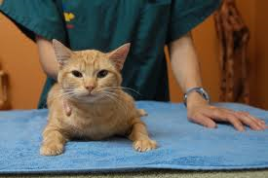
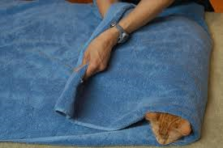
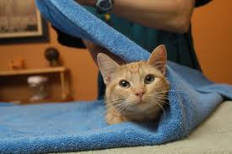
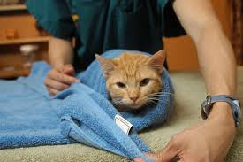
Introduction to Handling and Restraining animals!

Slide 2
Next Generation Science / Common Core Standards Addressed!

Slide 3
Agriculture, FOOD, AND Natural Resource Standards Addressed
AS.05.01. Design animal housing, equipment and handling facilities for the major systems of animal production.
AS.05.01.02.b. Analyze the use of modern equipment, technology and handling facility procedures and determine if they enhance the safe, economic and sustainable production of animals.

Slide 4
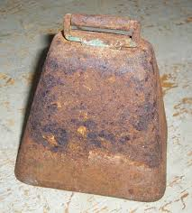
Bell work / Unit objectives!
Why is it necessary to restrain animals in a veterinary Clinic?
Who is generally responsible for restraining animals in a veterinary clinic?
What type of tools and equipment are used for animal restraint?

Slide 5
Terms
Adverse
Chemical
Discomfort
Disposition
Distress
Instinct
Physical
Psychological
Restraint
Slaughter

Slide 6
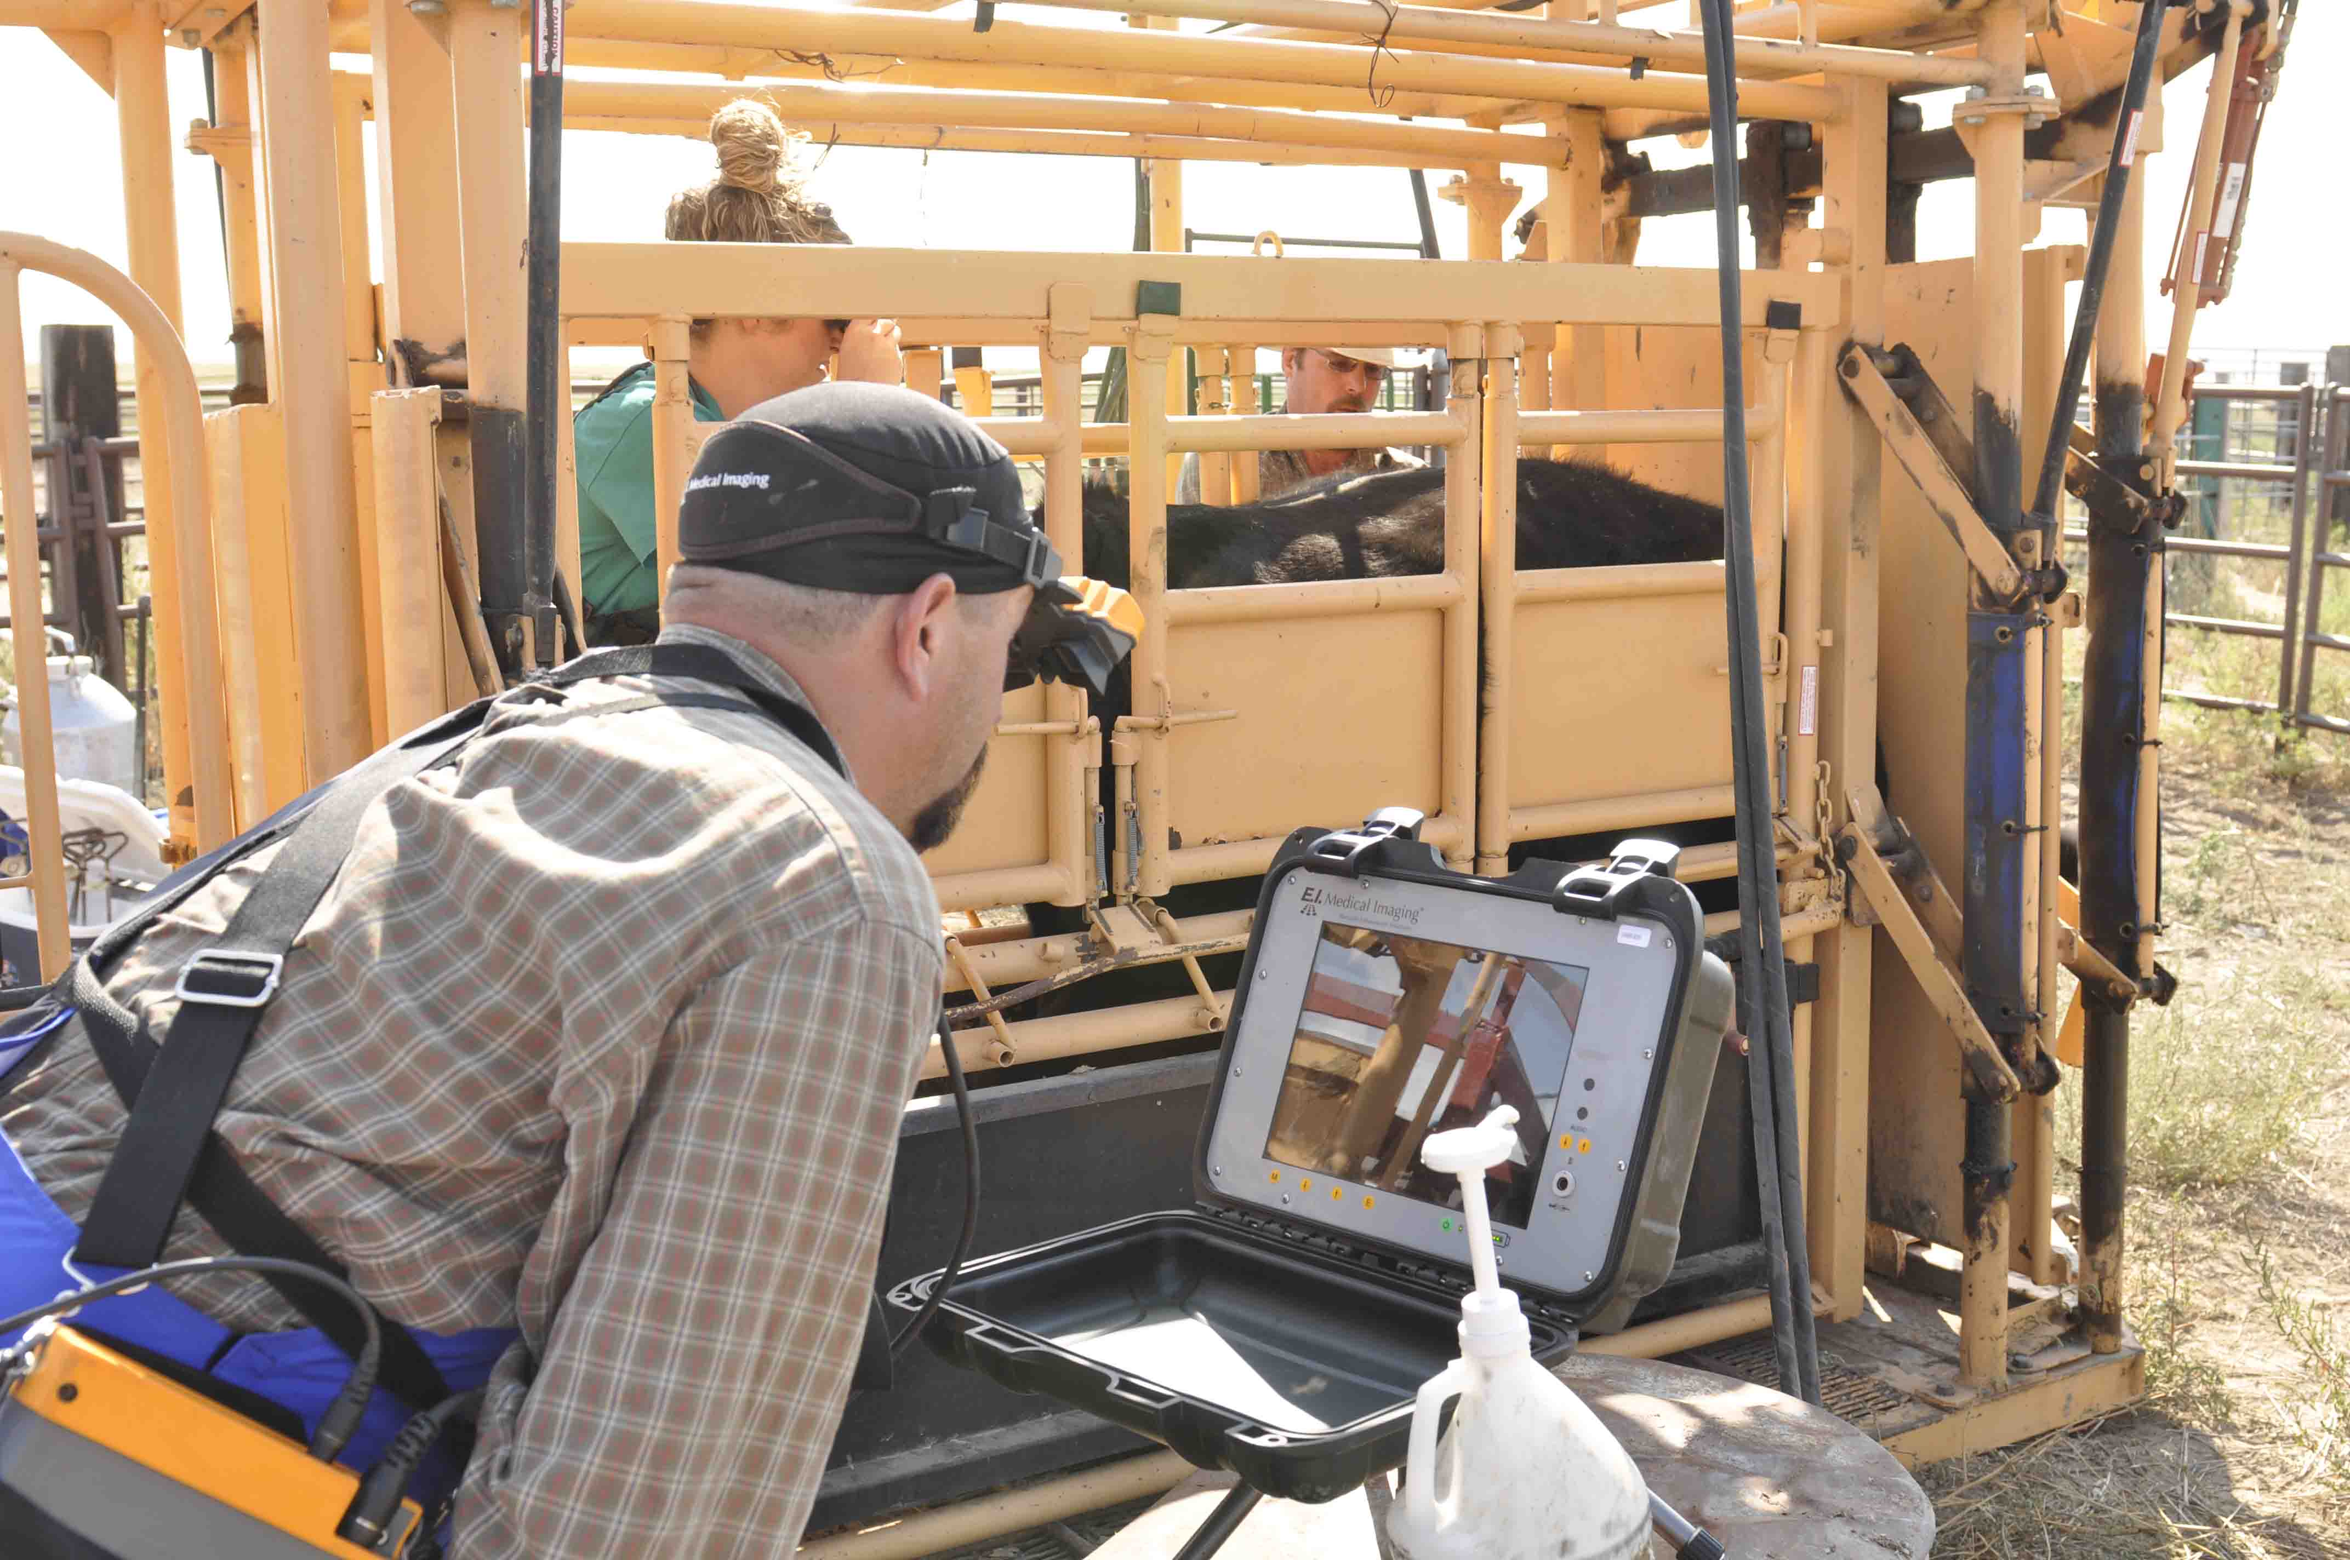
Animal restraint may be defined as – Controlling the movement and activity of an animal to prevent injury to themselves and their handlers.

Slide 7
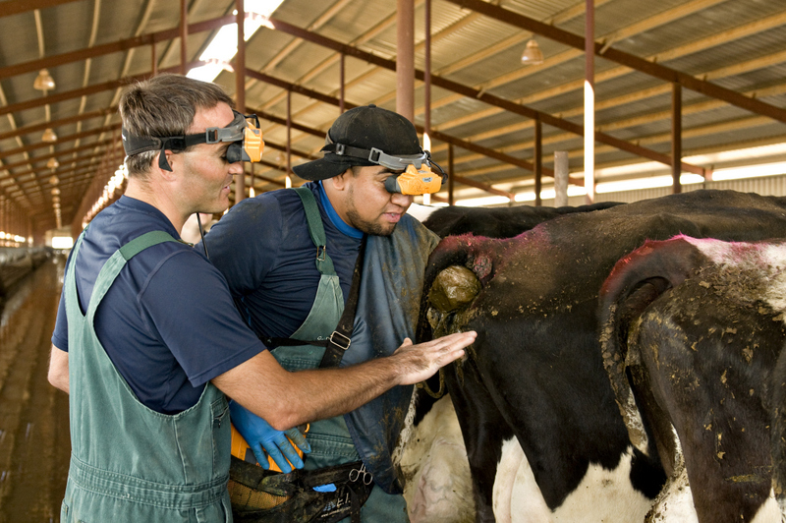
When is animal restraint needed?
It is not uncommon for food animals to be restrained numerous times from birth to slaughter.
Companion animals are normally restrained for medical exams and treatment.

Slide 8
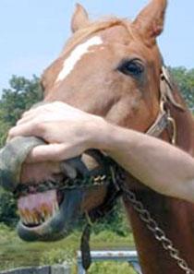
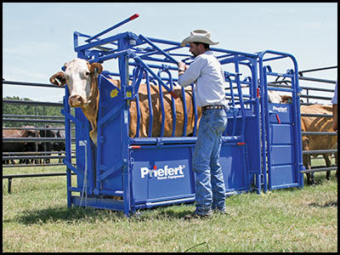
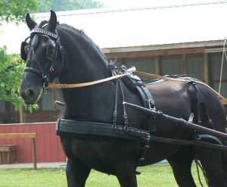
Animal restraints have been utilized since domestication began! Restraints were more common when animals were used for work, food and clothing.

Slide 9
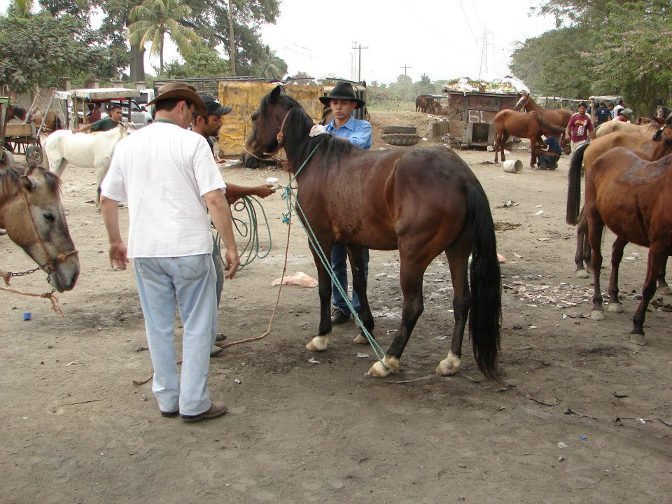
When restraining animals the rules of thumb are:
Use as little restraint as possible to complete task at hand.
Minimize animal discomfort and distress.
Minimize or eliminate the possibility of
Animal injury
Minimize the potential for human injury.

Slide 10
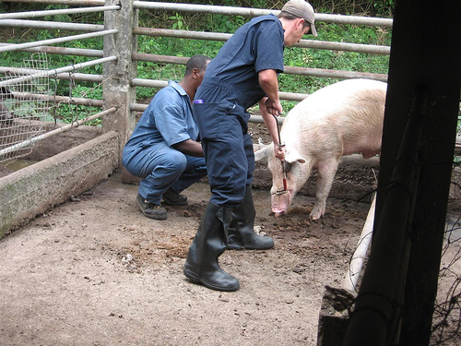
Restraint requires a knowledge of a variety of animals as well as their behavior.
A thorough knowledge of restraint devices that will be used.
Use of the minimal amount of restraint possible.
Remember the object of restraint is to protect the animal and handler.

Slide 11
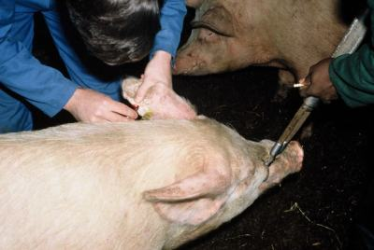
The type of restraint to be used is determined by :
Handler safety
Animal safety
Size and type of animal
Animal disposition
Facilities and equipment available for the process.
Handler knowledge and experience.

Slide 12
What are the Forms of Restraint?
Chemical – injections
Physical - chutes, ropes, twitch, snare
Psychological – training, herding instinct

Slide 13
Psychological restraint – the animal is trained to stand!

Slide 14
Physical Restraint – Perhaps Excessive?

Slide 15
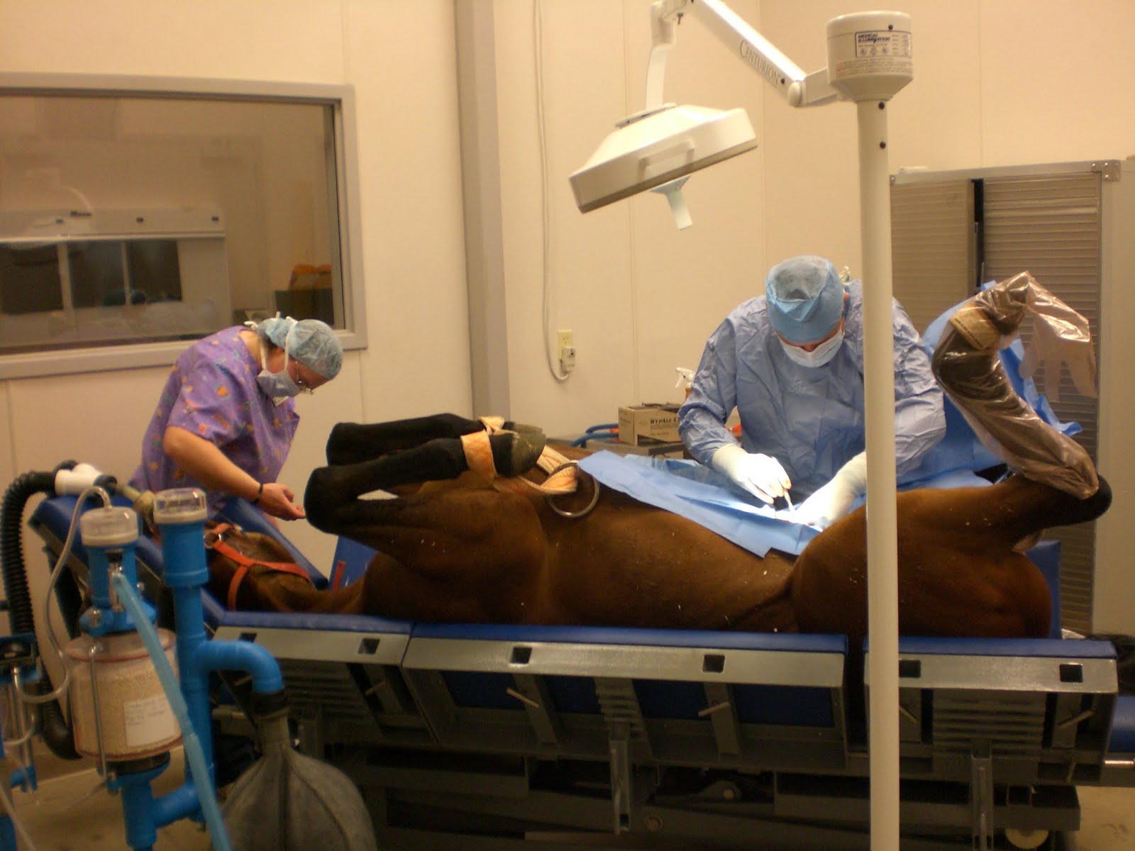
Chemical Restraint

Slide 16
Chemical Restraint May be Dangerous!
Calculate dosages carefully as the possibility of an overdose does exist.
Be prepared for the potential of a reaction to drugs that have been administered.
It may prove to be a costly alternative.
Be prepared for an adverse reaction as the patient comes out of the drugged state. Most patients tend to be scared, especially if the owner is not on the premises.

Slide 17
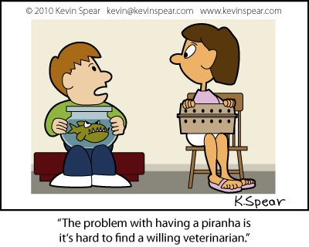
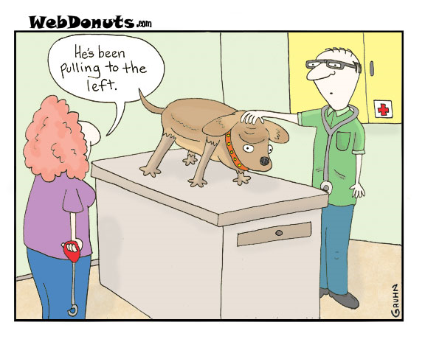
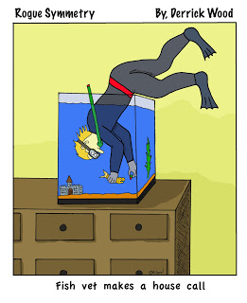
The End!

