Slide 1
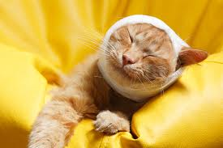
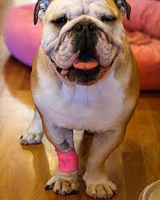
Applying Bandages and First Aid

Slide 2
Next Generation Science / Common Core Standards Addressed!
CCSS.ELA-Literacy.RH.11-12.4 Determine the meaning of words and phrases as they are used in a text, including analyzing how an author uses and refines the meaning of a key term over the course of a text (e.g., how Madison defines faction in Federalist No. 10).
CCSS.ELA-Literacy.RH.11-12.5 Analyze in detail how a complex primary source is structured, including how key sentences, paragraphs, and larger portions of the text contribute to the whole.
CCSS.ELA-Literacy.RH.11-12.7 Integrate and evaluate multiple sources of information presented in diverse formats and media (e.g., visually, quantitatively, as well as in words) in order to address a question or solve a problem

Slide 3
Agriculture, Food, and Natural Resource Standards Addressed
AS.07.01. Design programs to prevent animal diseases, parasites and other disorders and ensure animal welfare.
AS.07.01.02.b. Perform simple health-check evaluations on animals and practice basic emergency response procedures related to animals.

Slide 4
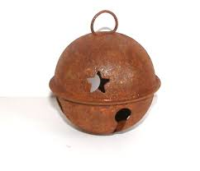
Bell Work!
Describe HOW YOU WOULD APPLY A PRESSURE BANDAGE TO A HORSES FORE LEG.
2. Explain how a bandage may cause Irritation.
3. Describe first aid for a bleeding wound.
4. What is first aid?
5. How would you support a cat’s broken leg?

Slide 5
Terms!
Artery
Clotting
Hemorrhaging
Mucous membranes
Tourniquet
Unconscious
Vein

Slide 6
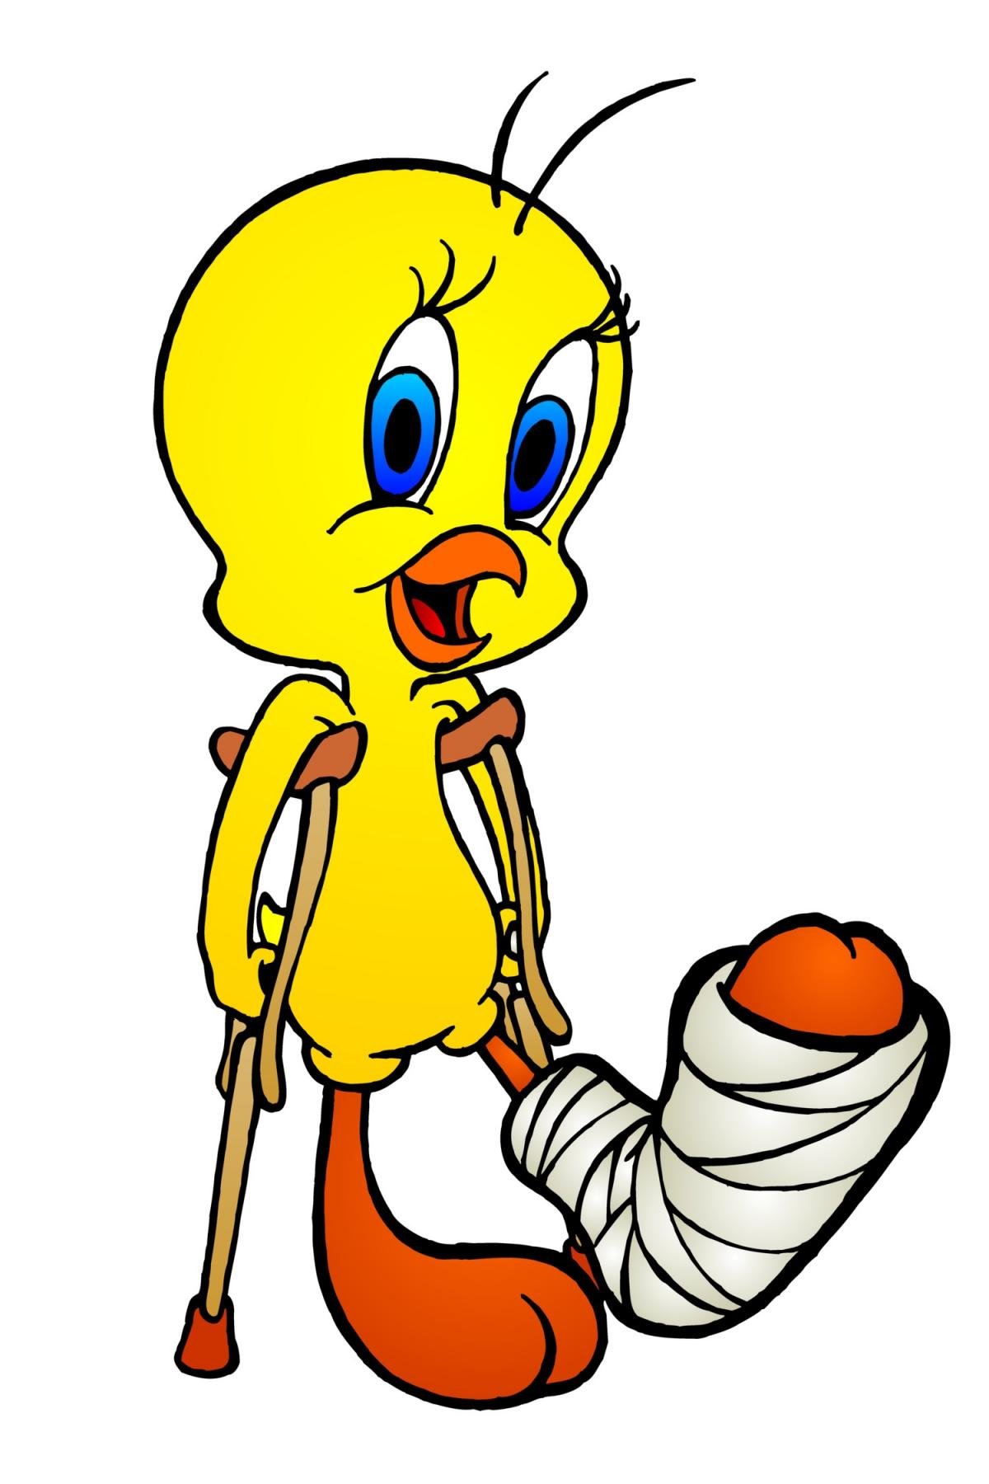
Introduction
Initial care that is given to a patient prior to a complete medical evaluation is conducted is referred to as “first Aid”.
Immediate attention may lessen the injury, reduce bleeding, and prevent death.
Injured animals can suffer shock, broken bones, hemorrhaging or even be unconscious. Animals must be handled carefully and restrained without further injury.

Slide 7
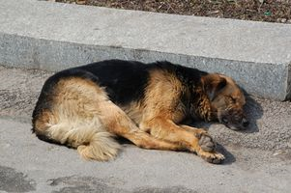
Applying Bandages and First Aid
Shock may occur if an animal has been injured.
The signs of shock would include gums that may be pale, blue or gray in color and an elevated heart rate 1 ½ to 2 times the normal pulse rate. Keep the animal still and cover with a blanket except in extremely hot weather.

Slide 8
Applying Bandages and First Aid
To control blood flow properly you must determine the source of the blood flow.
Blood flowing from a vein will be dark in color and flow freely, while blood from an artery is bright red and spurts with the beat of the heart. Blood flow must be stopped before further action may be taken. Hand pressure should be applied above the wound if flow is from an artery, below the wound if the flow is coming from a vein.
All wounds should be cleaned, covered and antibiotics administered.
If the injury is severe enough for a tourniquet, it should be loosened every ten to fifteen minutes.

Slide 9
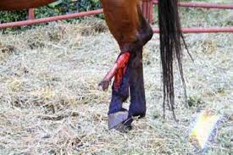
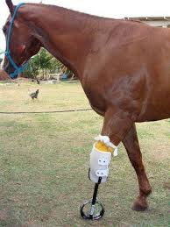
Applying Bandages and First Aid
An animal that refuses to move and has labored breathing is most likely in pain and may have a broken bone or a damaged joint.
If it is determined that the animal does have a broken bone a temporary splint should be applied to prevent further damage.

Slide 10
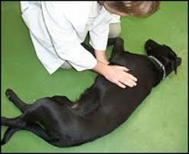
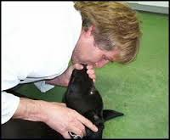
Applying Bandages and First Aid
Small animals that are exhibiting symptoms of respiratory distress may require artificial respiration.
Respiratory distress may be the result of trauma, circulatory problems, drowning, or anaphylactic shock.

Slide 12
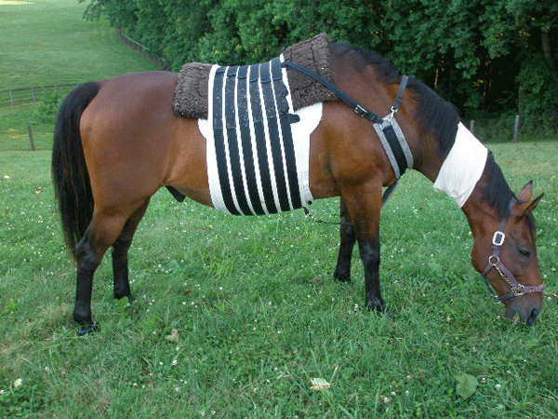
Applying Bandages and First Aid
Bandages are used on animals as a means of pressure application to a wound. Bandages also serve as a mechanism to keep the wound clean and hopefully free of irritation.
Generally animals will have bandages applied to the lower limbs than elsewhere on the body.

Slide 13
Applying Bandages and First Aid
Pressure Bandage – a pressure bandage may serve three different purposes
Restrict movement
Minimize swelling
Control bleeding
Generally 1-2” of padding is covered with elastic wrap, avoid wrapping the bandage too tight as it may cause further damage by restricting blood flow.

Slide 14
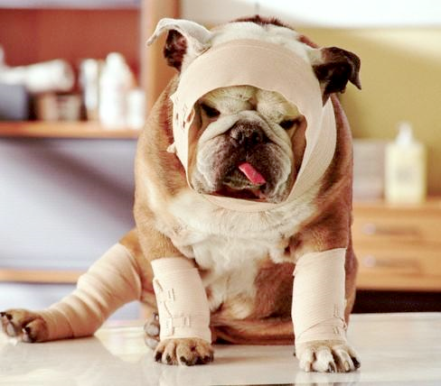
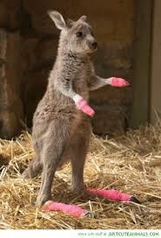
Applying Bandages and First Aid
Wound Bandages – Elastic wrap or tape should be used to hold a bandage in place. Antibiotics may be applied directly to the wound before the bandage is put in place.

Slide 15
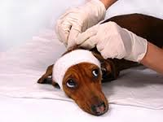
Applying Bandages and First Aid
Bandaging Guidelines
Do not apply the bandage too tight as it may cause, discomfort, tissue damage and possibly lameness.
Keep the animal in a dry, clean area to protect the bandage.
Replace bandages periodically to allow for cleaning of the wound and further antibiotic application.
Apply fly and insect repellent if necessary.

Slide 16
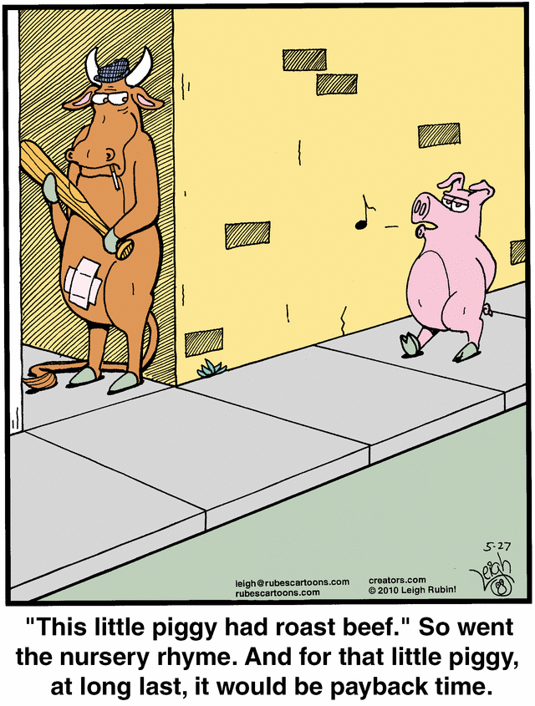
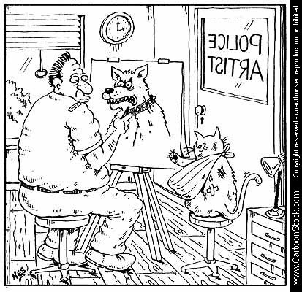
The End

