Slide 1
From Birth to Weaning!

Slide 2
Common Core/Next Generation Science Standards Addressed!
CCSS.ELA-Literacy.RH.11-12.8 Evaluate an author's premises, claims, and evidence by corroborating or challenging them with other information.
CCSS.ELA-Literacy.RH.11-12.2 Determine the central ideas or information of a primary or secondary source; provide an accurate summary that makes clear the relationships among the key details and ideas

Slide 3
Agriculture, Food, and Natural Resource Standards Addressed
AS.04.02. Apply scientific principles to select and care for breeding animals.
AS.04.02.04.a. Identify and summarize different needs of breeding animals based on their growth stages (e.g., newborn, parturition, gestation, gestation lengths, etc.)

Slide 4
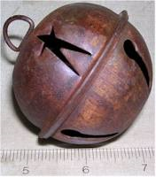
Bell Work!
Explain what parturition is and the three stages of parturition.
At what age should the following species of animals be weaned? Foals, pigs, beef cattle, dairy cattle, lambs and kids.
What is colostrum and why is it important?
Explain “pre-conditioning”.
Explain “backgrounding”.
What is creep feeding?

Slide 5
Terms:
Abdominal
Anorectic
Colostrum
Creep Feeding
Dystocia
Fetus
Obstetrical
Parturition
Stress
Weaning

Slide 6
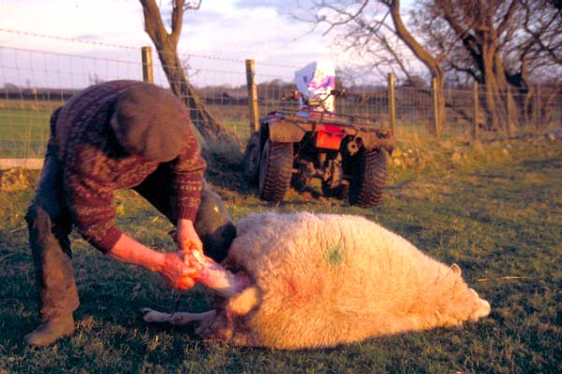
Introduction!
The scientific word used to describe difficulty during the birthing process is “dystocia”.
In all females delivering for the first time dystocia is a possibility. First calf beef heifers seem to be the area where dystocia occurs the most. It is not uncommon for up to 50% of first calf beef females to experience difficulty. In cattle it is very important to use bulls that sire calves with small birth weights.

Slide 7
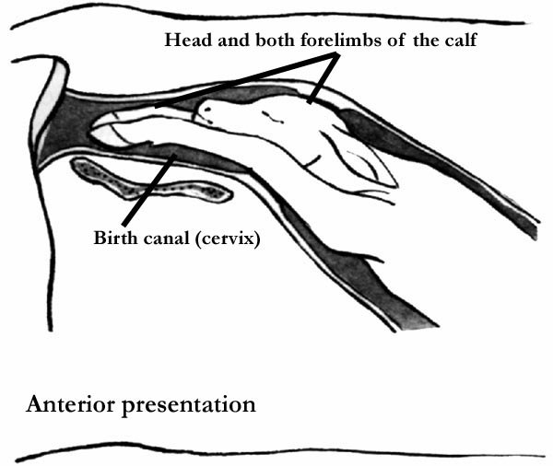
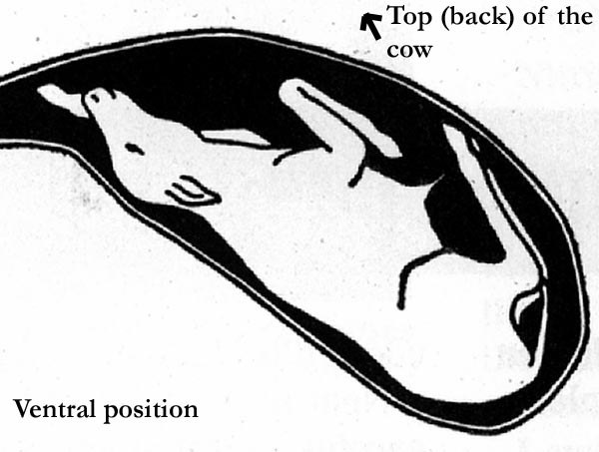
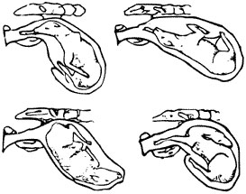
Correct! Incorrect!

Slide 8
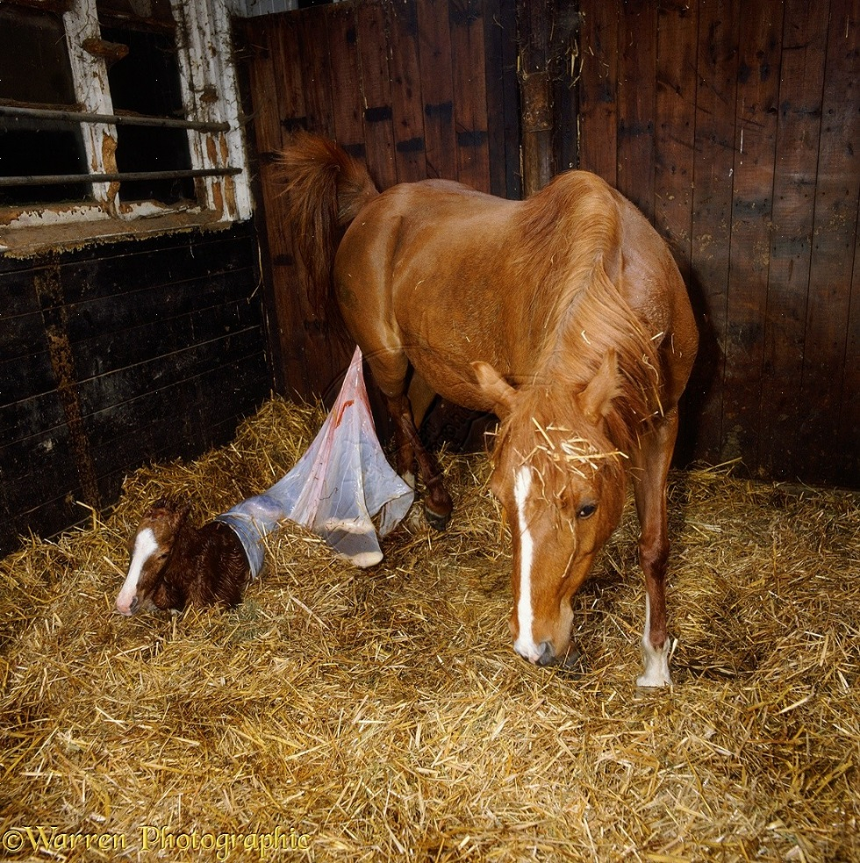
Parturition!
Parturition is the term that is used to describe the birthing process from the time labor starts until the new animals have been delivered.
Parturition consists of three steps:
Presentation
Position
Posture

Slide 9
Parturition Cont.
Presentation refers to the direction of the fetus once it has begun to enter the birth canal – forward, backward, sideways.
Position refers to the whether the animal is right side up or upside down.
Posture refers to the position of the head an neck in relation to the feet an legs.
Improper presentation, position or posture will result in dystocia.

Slide 10
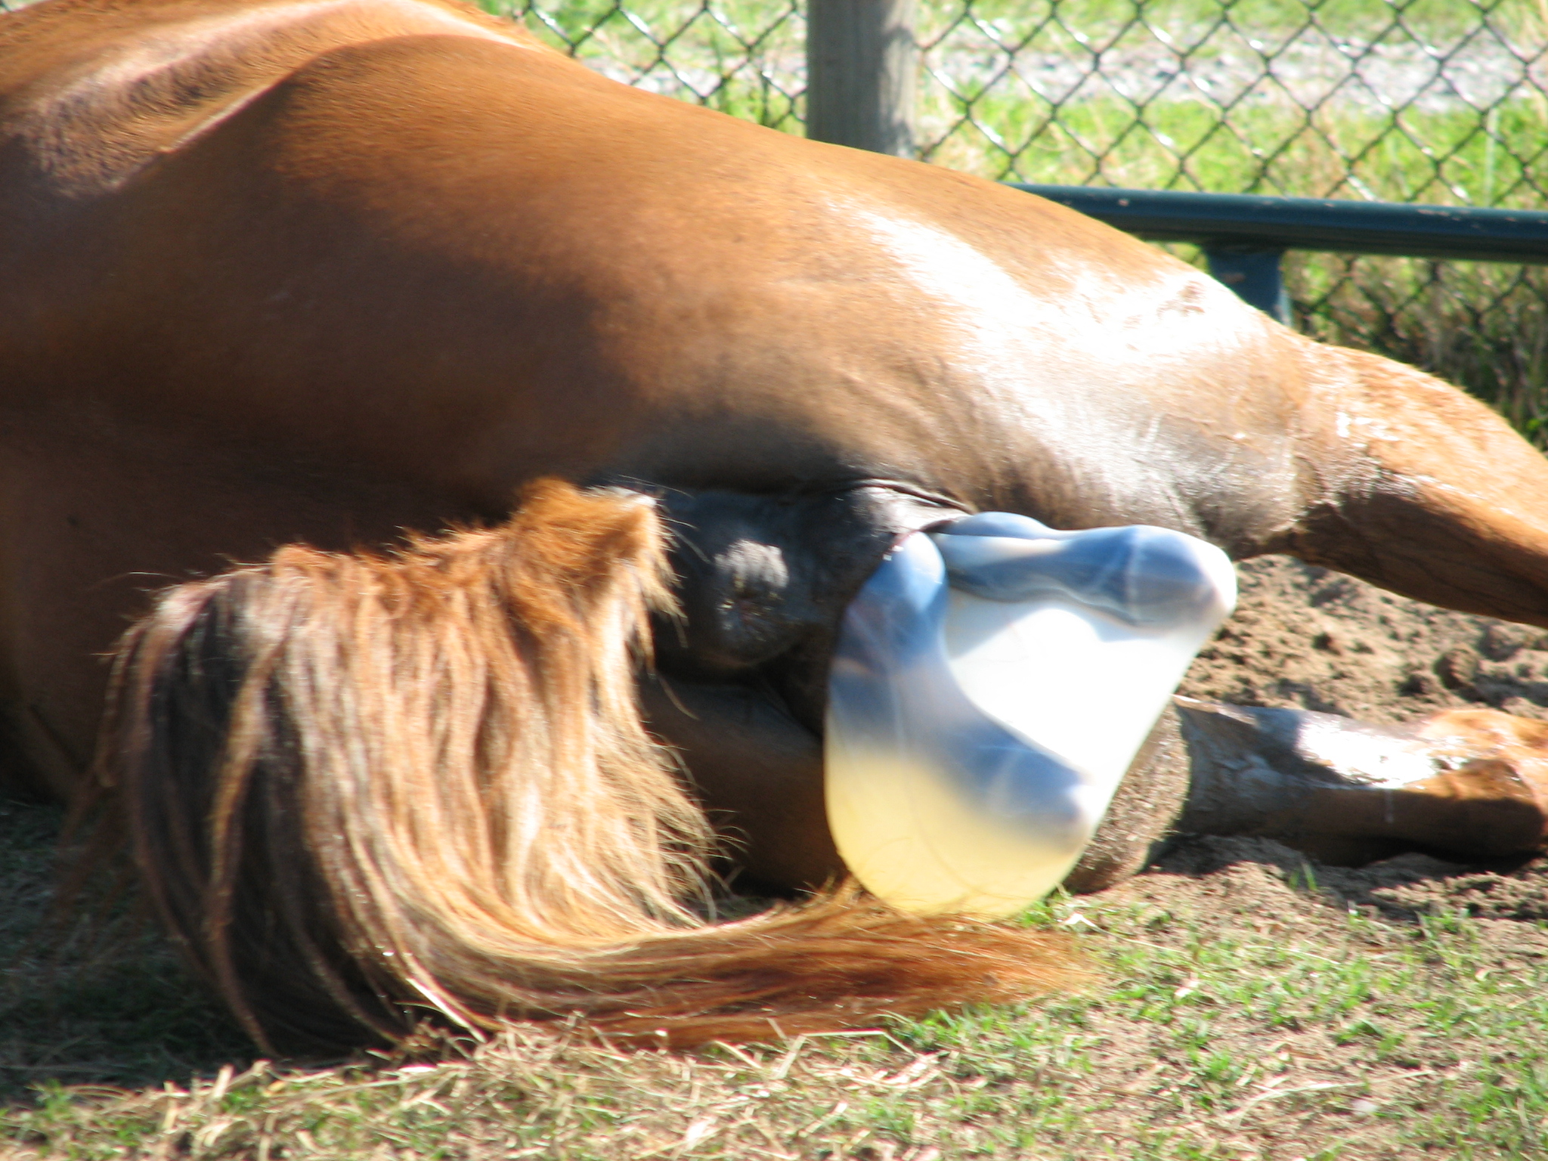
Parturition Cont.
Parturition may be divided into three stages. The time of each sequence will vary from one animal to another.
Stage 1 is primarily dilation of the cervix. The female will be very restless and may stand and lie down frequently.
Stage 2 is the expulsion of the fetus “labor”. Straining and pain will be evident during stage 2.
Stage 3 is the expulsion of the fetal membrane. (after birth)

Slide 11
Assisting with parturition.
When making the decision to assist the female during stage 2 “labor” several factors should be considered.
1. How long has the female been in labor?
2. Is the offspring in the proper position?
3. Is it obvious that the animal is weakening and unable to push the offspring out of the birth canal.
4. The offspring is beginning to exit the birth canal in the wrong position.

Slide 12
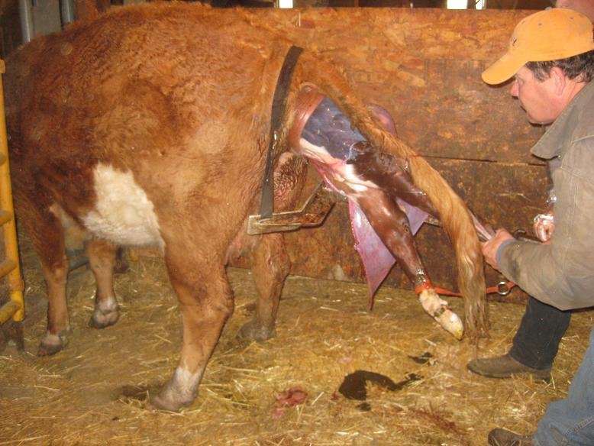
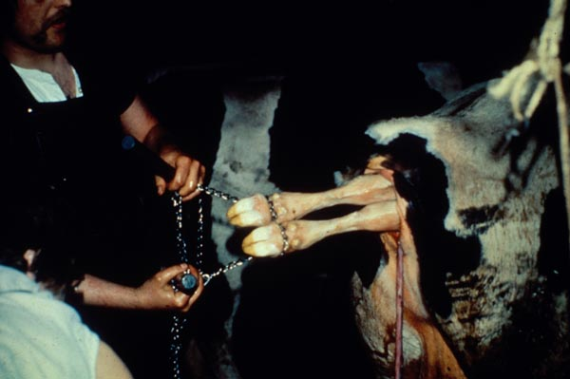
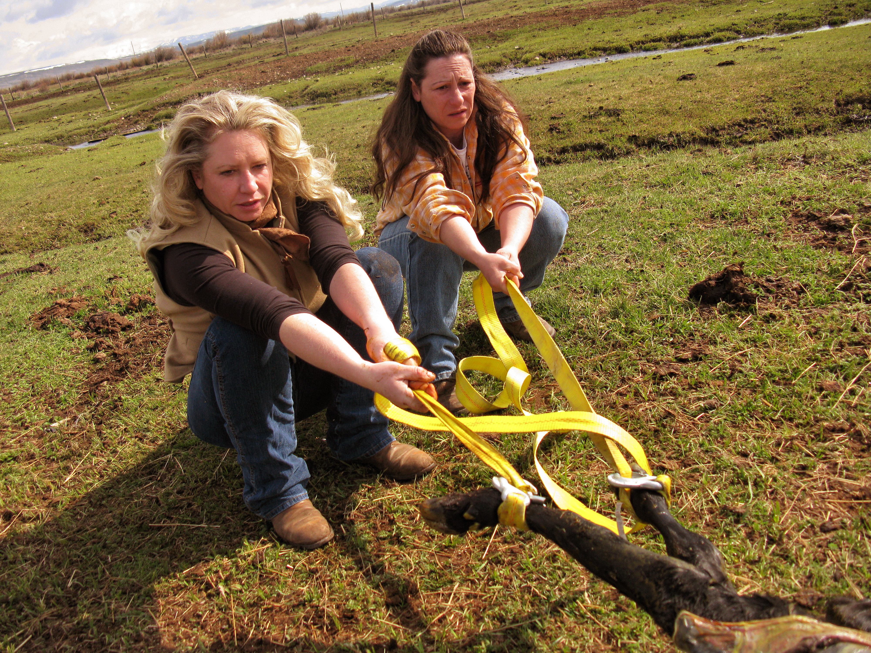
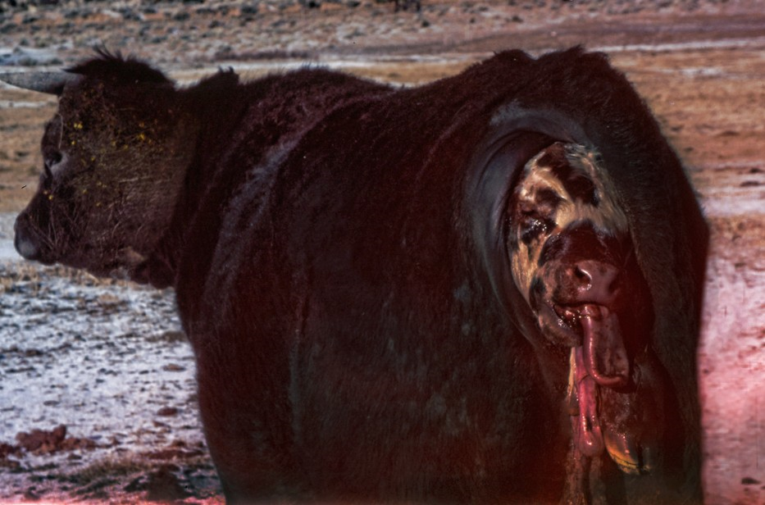
Providing Assistance!

Slide 13
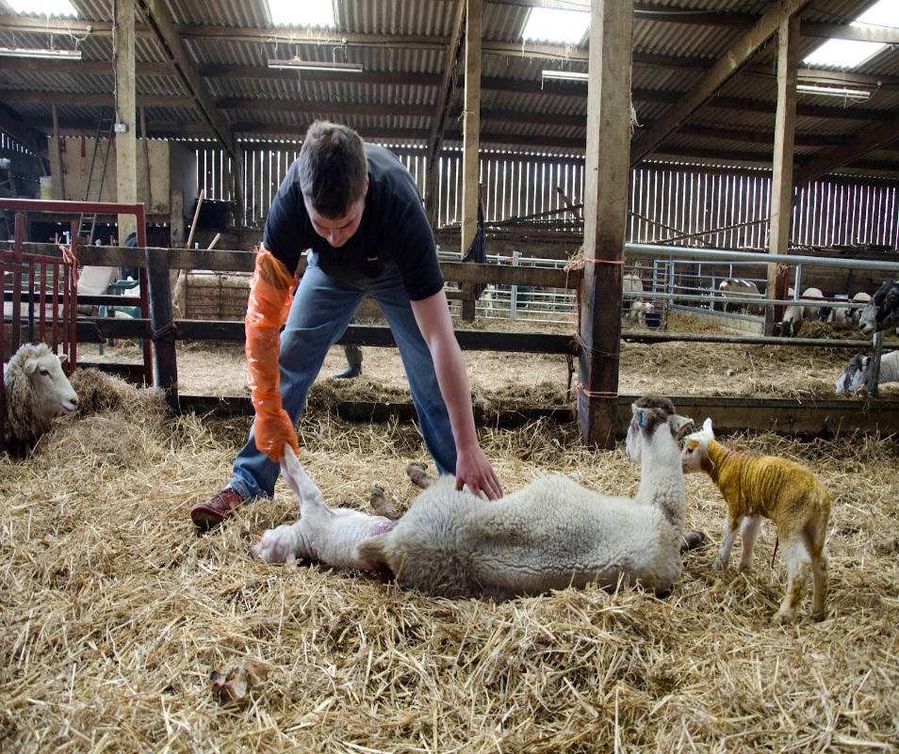
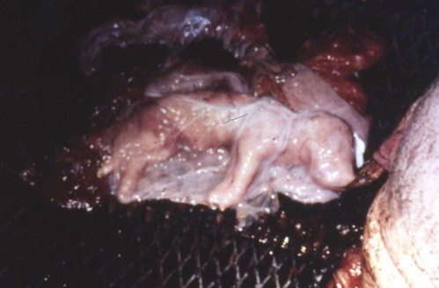
Providing Assistance!

Slide 14
Assisting with parturition & Post Partum
When assisting smaller animals such as sows, ewes and goats you can generally assist by inserting your hand into the reproductive tract grasping the fetus and using a steady pressure pull the animal free.
With larger animals such as cattle ropes, obstetrical chains or straps or pulling tools may be necessary to remove the fetus.
Once the young animal has been delivered it may be in a weakened state, it is a good idea to clean the mouth and nose area so that it will be easier to breath.
Rubbing the young animal and gently pressing on its rib cage may assist with breathing.
Mouth to mouth respiration has been performed on many animals.
Make sure that all offspring receive colostrum (first milk) within the first few hours after birth as colostrum contains more nutrients and antibodies than normal milk. Weak animals may not nurse and become anorectic.

Slide 15
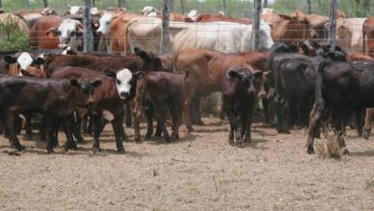
Weaning young animals.
Weaning is the separation of young animals from their dams (mothers).
The purpose of weaning is it allows the dam to recover physically, gain weight and prepare for the next breeding, birthing and nursing cycle.
Age of weaning;
Beef cattle area generally weaned between 5-9 months of age.
Dairy calves may be taken off the bottle as early as six to weeks of age.
Lambs and kids may be weaned at two months to ten weeks of age.
Pigs can be weaned as early as three weeks but may be left up to six weeks.
Foals are weaned from four to six months of age.

Slide 16
Creep feeding and Pre-conditioning animals.
Animals raised in confinement generally have access to feed at a young age. Young animals are fed in areas free choice where access is denied to the dam.
High protein feeds are supplied to young animals to maximize growth.
Range raised stock are more difficult to creep feed, it may not be practical for supplemental feeding until the young animals are penned and separated from the dam. This process of post weaning feeding is known as backgrounding.

Slide 17
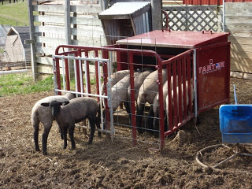
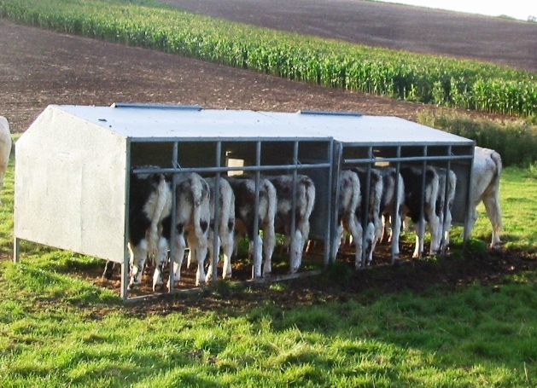
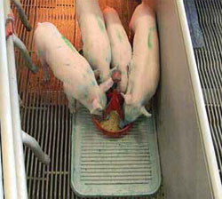
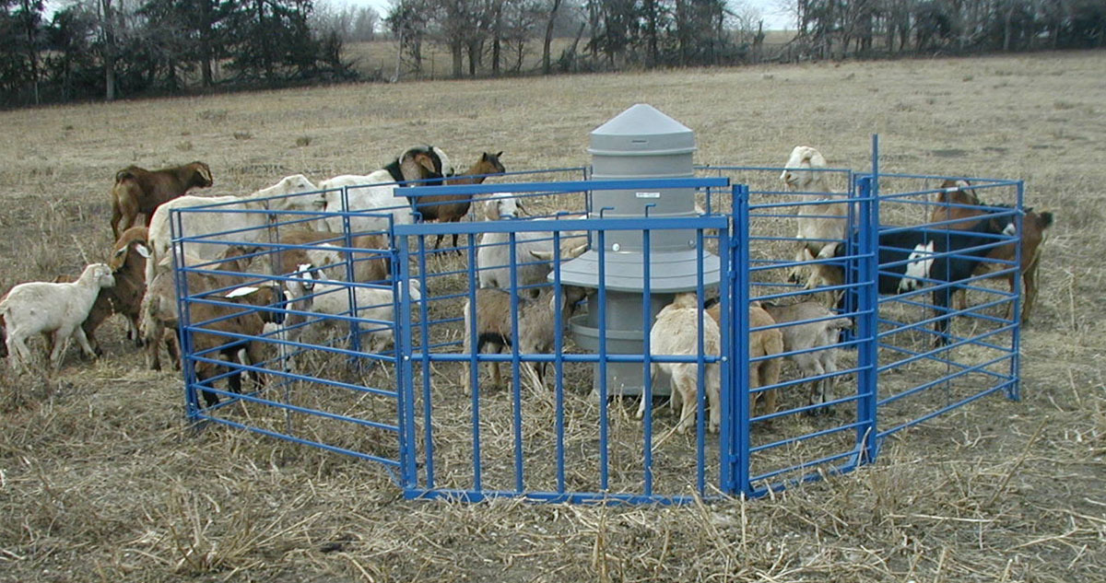
Creep Feeders

Slide 18
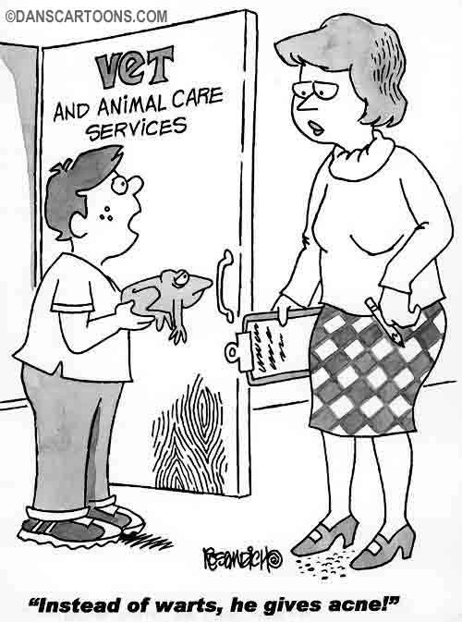
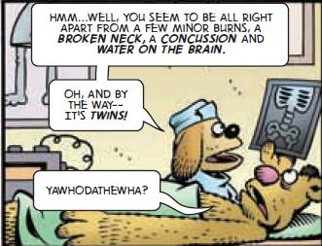
The End!

