Slide 1
FFA Floriculture Contest
Tool Identification

Slide 2
Standard Centerpiece Container

Slide 3
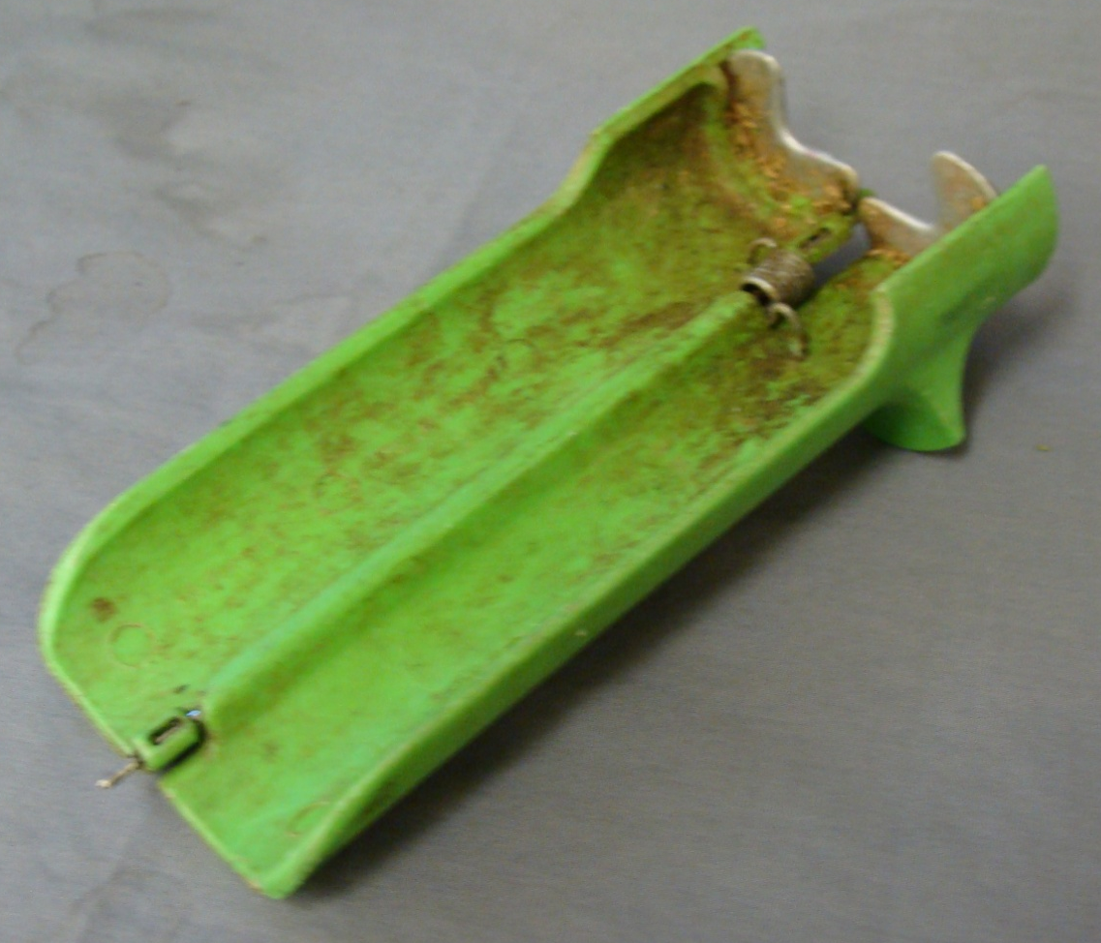
Stem Stripper

Slide 4
Floral Knife

Slide 5
Cowie Picks

Slide 6
Wire Cutters

Slide 7
Bypass Shears

Slide 8
Waterproof Tape

Slide 9
Ribbon Shears

Slide 10
Stem Stripper

Slide 11
Hot Glue Sticks

Slide 12
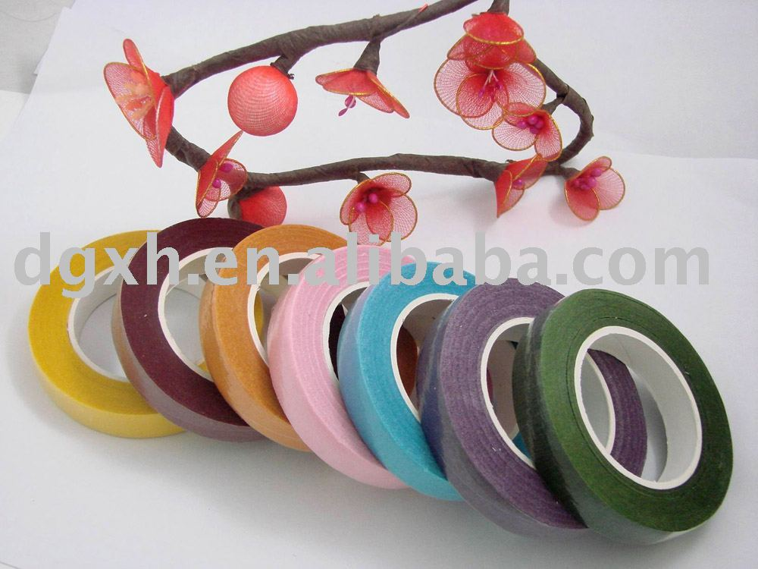
Corsage Tape

Slide 13
Anchor Pin

Slide 14
Zip Ties

Slide 15
Pipe Cleaner

Slide 16
Glue Pan Pillows

Slide 17
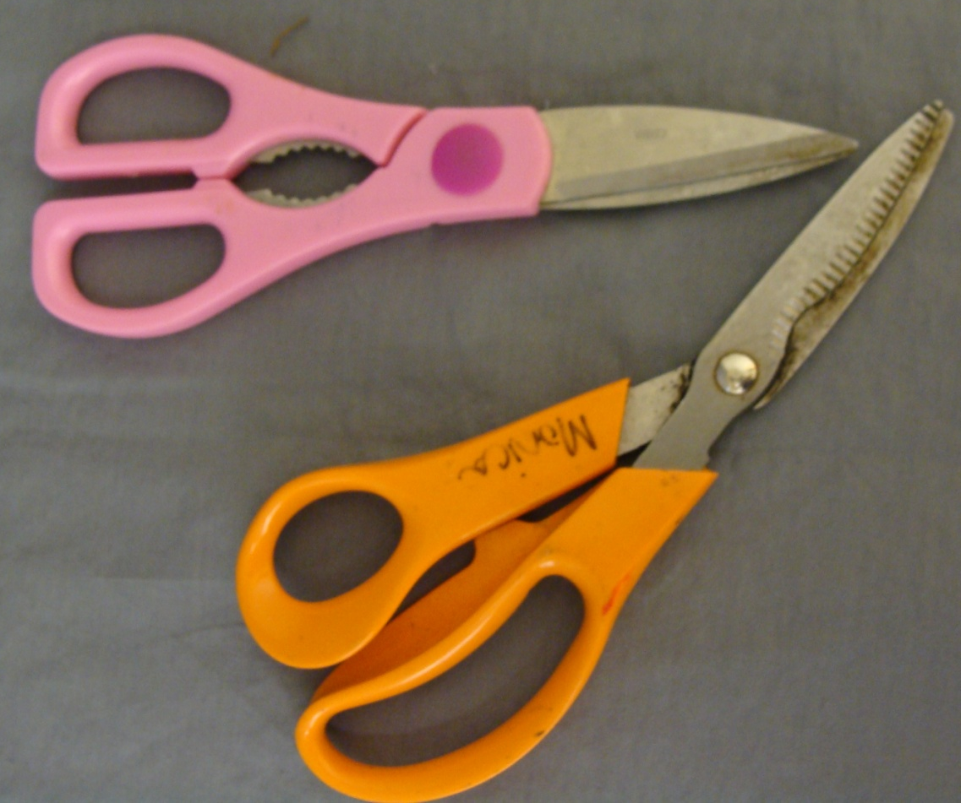
Floral Shears

Slide 18
Clear Waterproof Tape

Slide 19
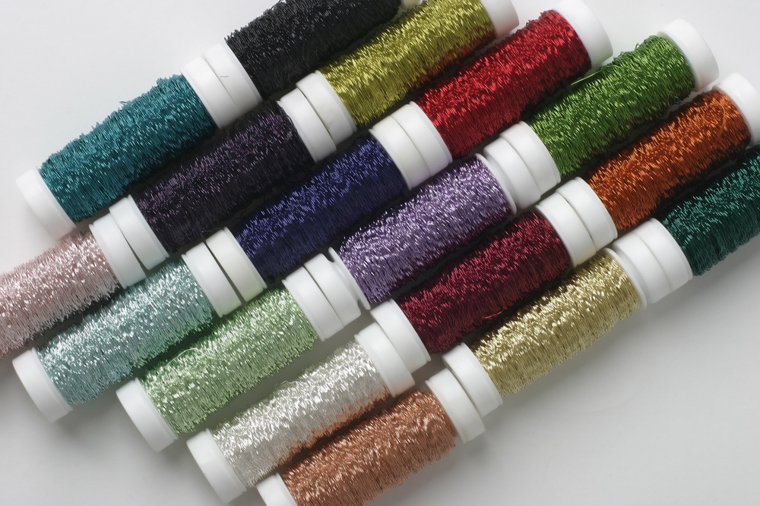
Bullion Wire

Slide 20
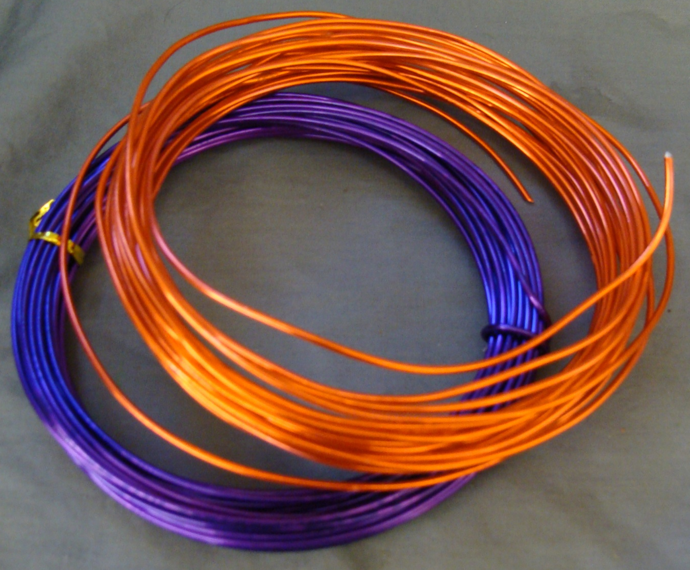
Aluminum Wire

Slide 21
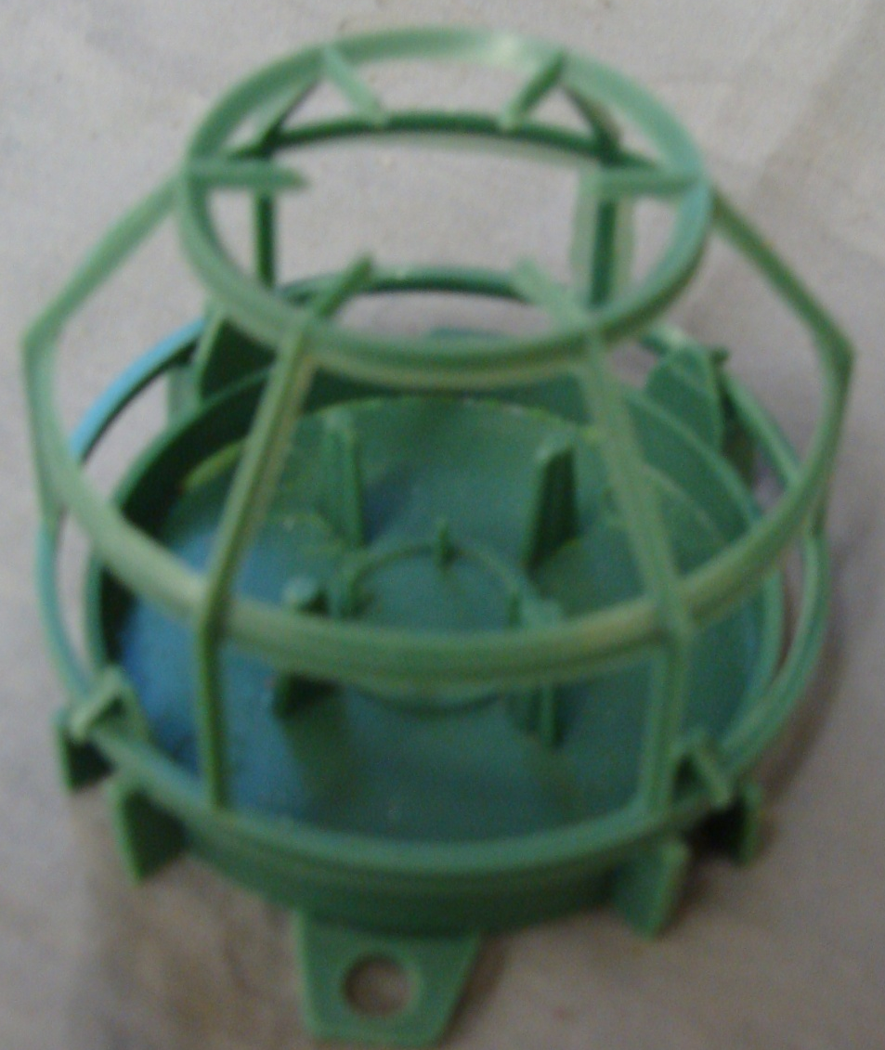
Foam Container / Oasis Cage

Slide 22
Bind Wire

Slide 23
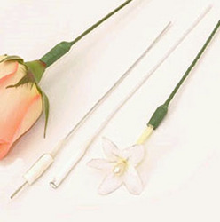
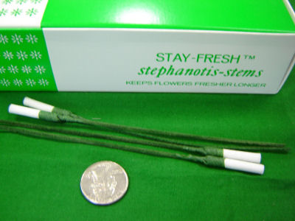
Stephanotis Stems

Slide 24
Cardette Holders

Slide 25
Fishing Line / Monofilament

Slide 26
Floral Foam

Slide 27
Corsage Bag

Slide 28
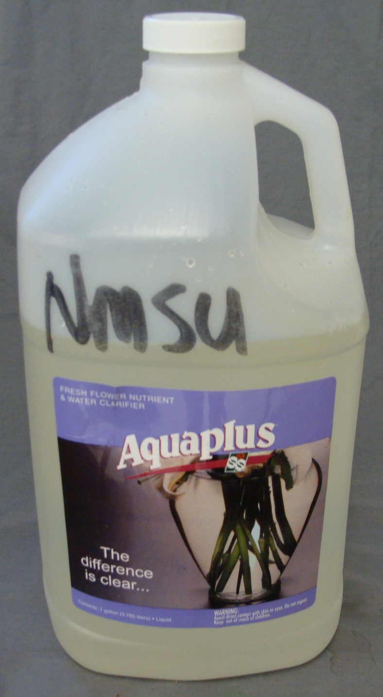
Floral
Preservative

Slide 29
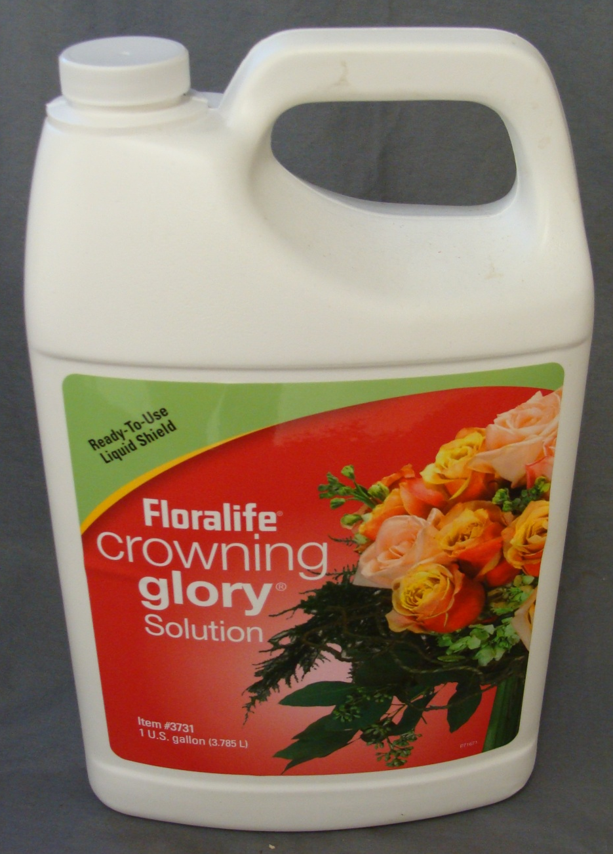
Crowning Glory Solution

Slide 30
Tack 2000 Spray Adhesive

Slide 31
Design Master

Slide 32
Flora Lock Stem Adhesive

Slide 33
Green Glo
Plant Polish

Slide 34
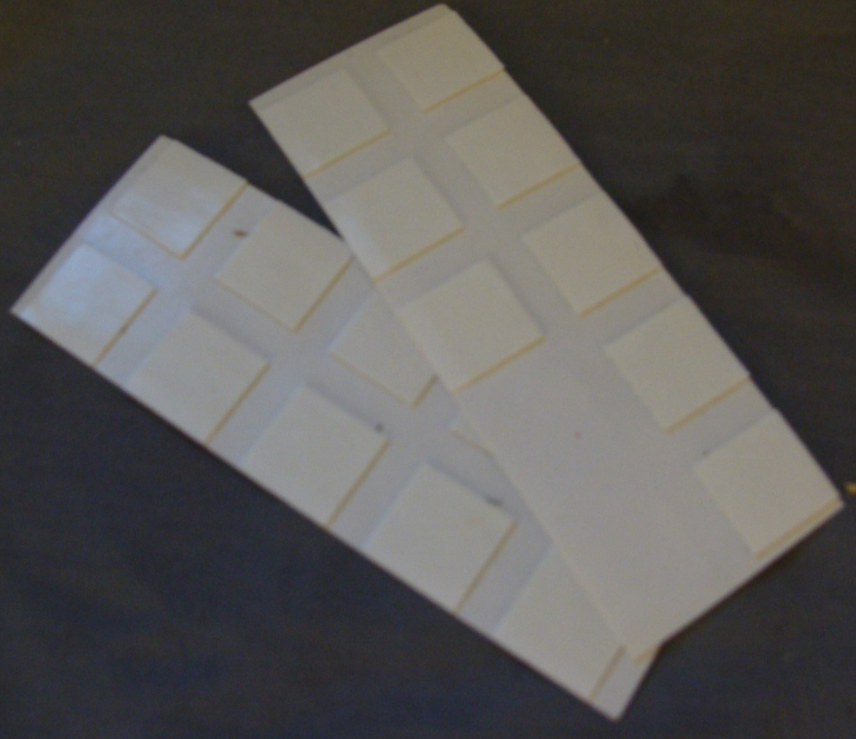
Glue Dots

Slide 35
Water Pick

Slide 36
Greening Picks

Slide 37
Corsage Pins

Slide 38
Bud Vase

Slide 39
Dozen Rose Vase

Slide 40
Oasis Floral Adhesive

Slide 41
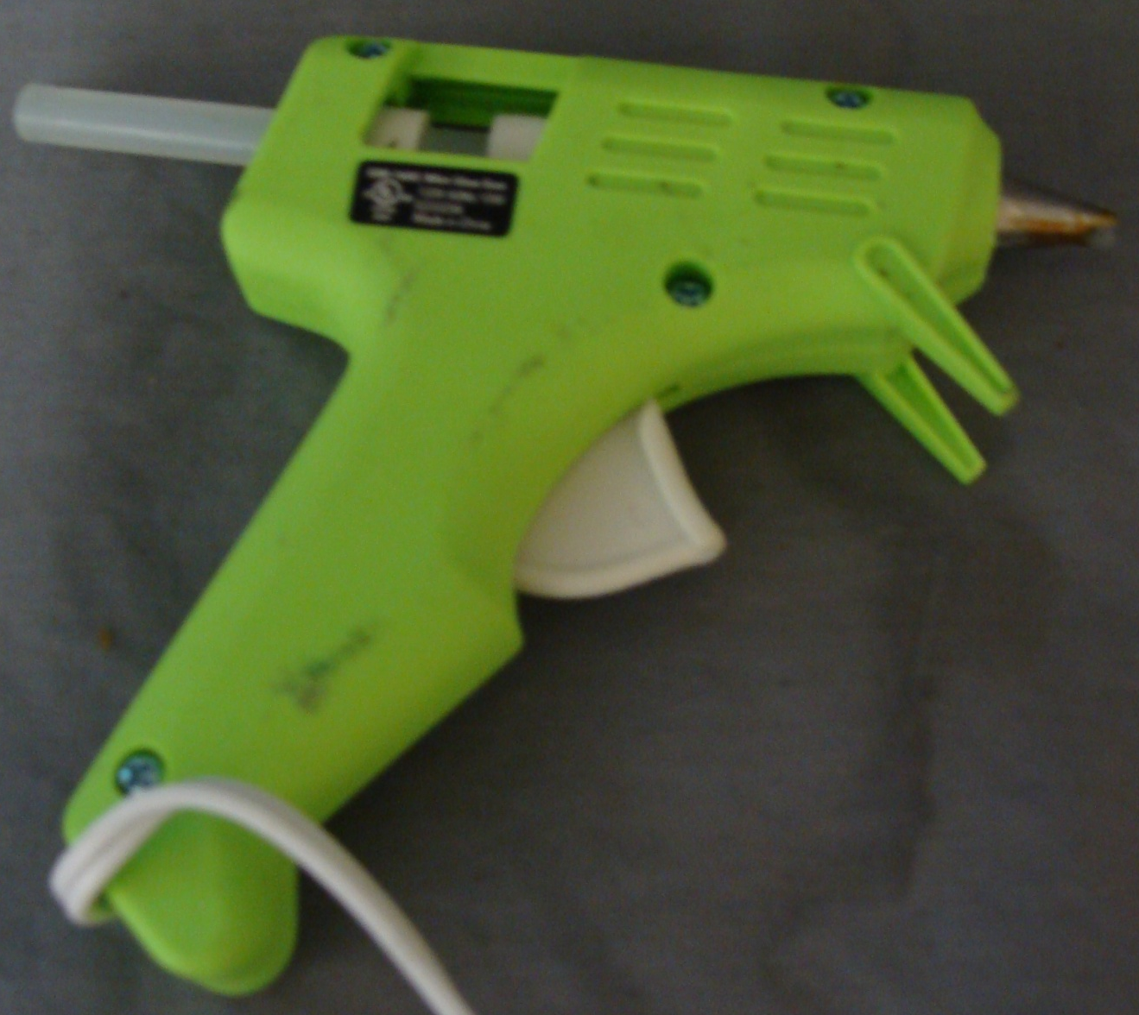
Hot Glue Gun

Slide 42
Corsage Wristlet

Slide 43
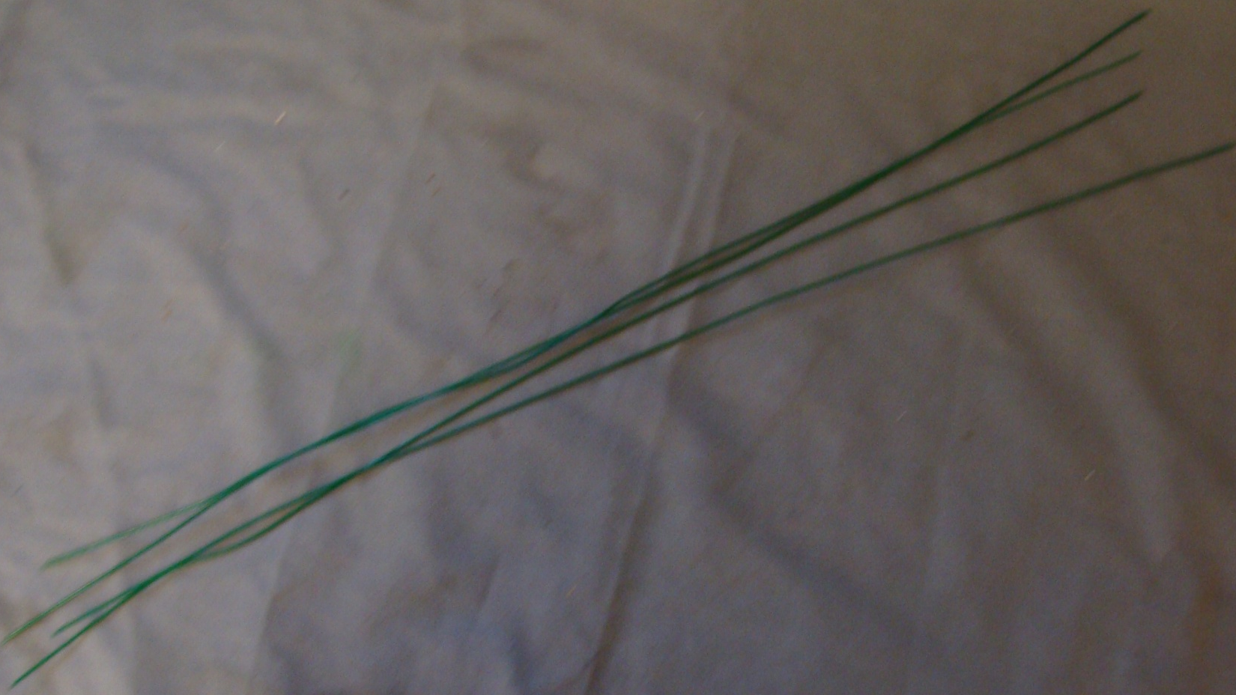
Floral Wire

Slide 44
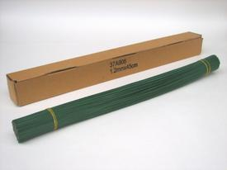
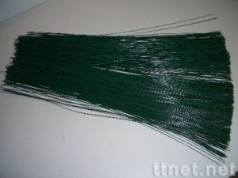
Gerbera Wire

Slide 45
Glue Pan

